Slide 1
while(true){}
Presents
Ping.IT
Stuart Bowman, Zared Hollabaugh, Caelan Mayberry, Ben Stegner, Justin Sybrandt

Slide 2

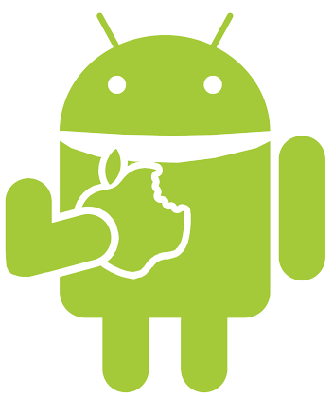
Ping.IT
Helpdesk Companion for TLC
Android Application
Notes:
If you are unaware of what the TLC is, they provide services to students and faculty with technical difficulties.

Slide 3
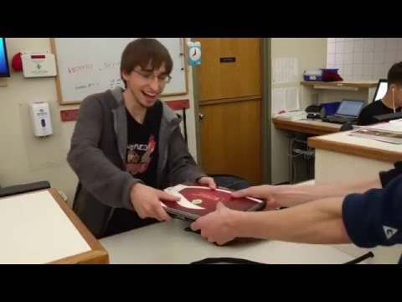
Promo

Slide 4
Ping.IT’s Purpose
Expedite helpdesk interactions
Move users off rush hour
Reduce waiting
Increase laptop throughput

Slide 5
Ping.IT’s Users
Grove City College students
Get help anywhere
Convenient notification

Slide 6
Ping.IT’s Users
Grove City College students
Helpdesk staff
Easy addition to normal workflow
Easier to return equipment

Slide 7
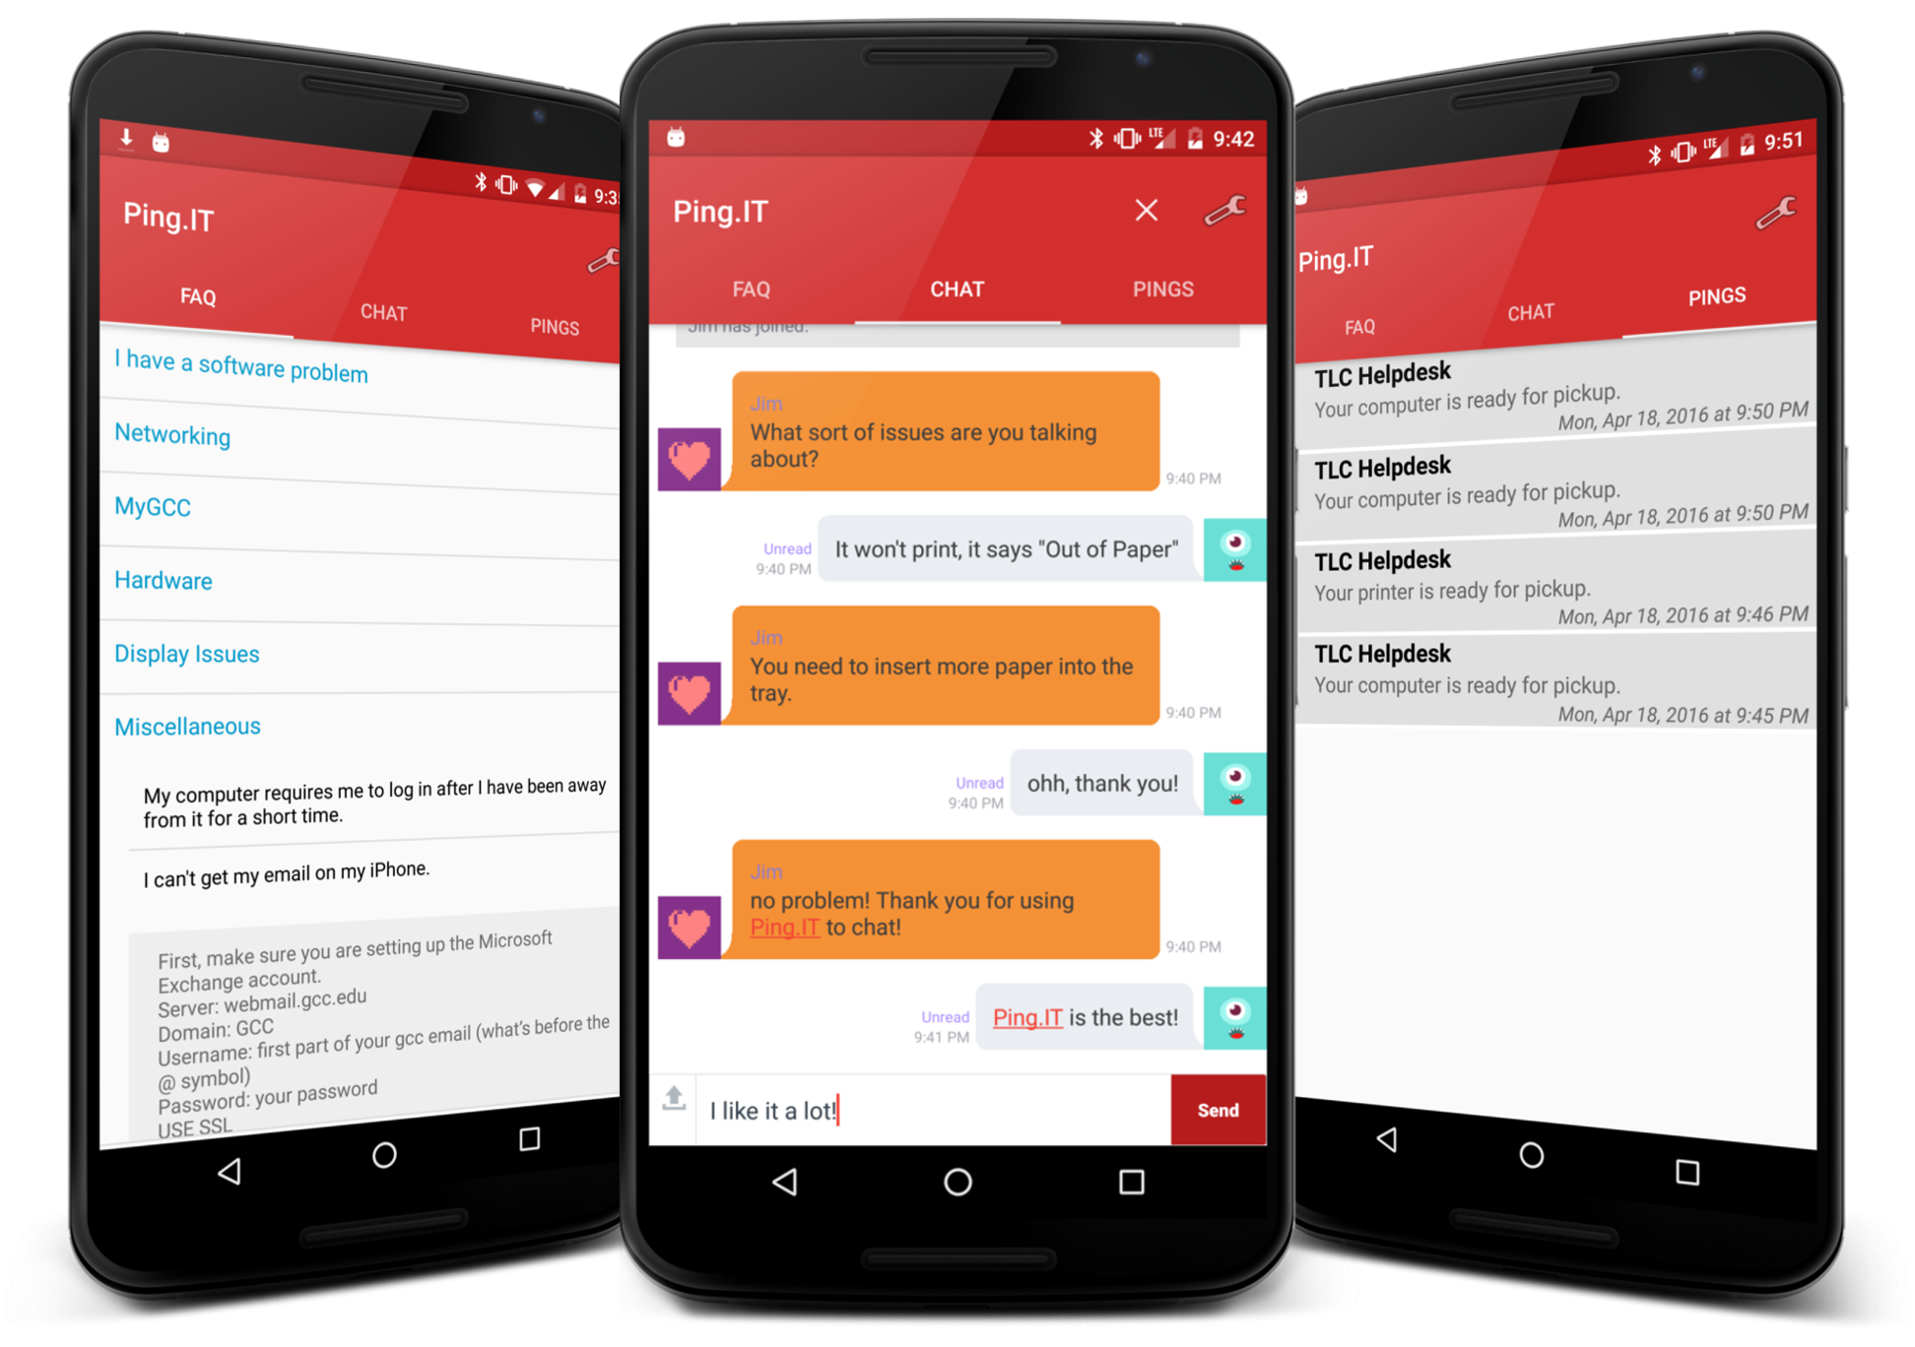
Main Features

Slide 8
Development & Testing Process
Distributed work
Individual branches
Standardized code review process

Slide 9
Development & Testing Process
Independent work
Build server
Automatic unit and integration tests
Caught errors before they became an issue

Slide 10
Development & Testing Process
Independent work
Build server
Bug Tracking
Categorized, tracked, and assigned bugs
Ensured bugs were fixed on time

Slide 11
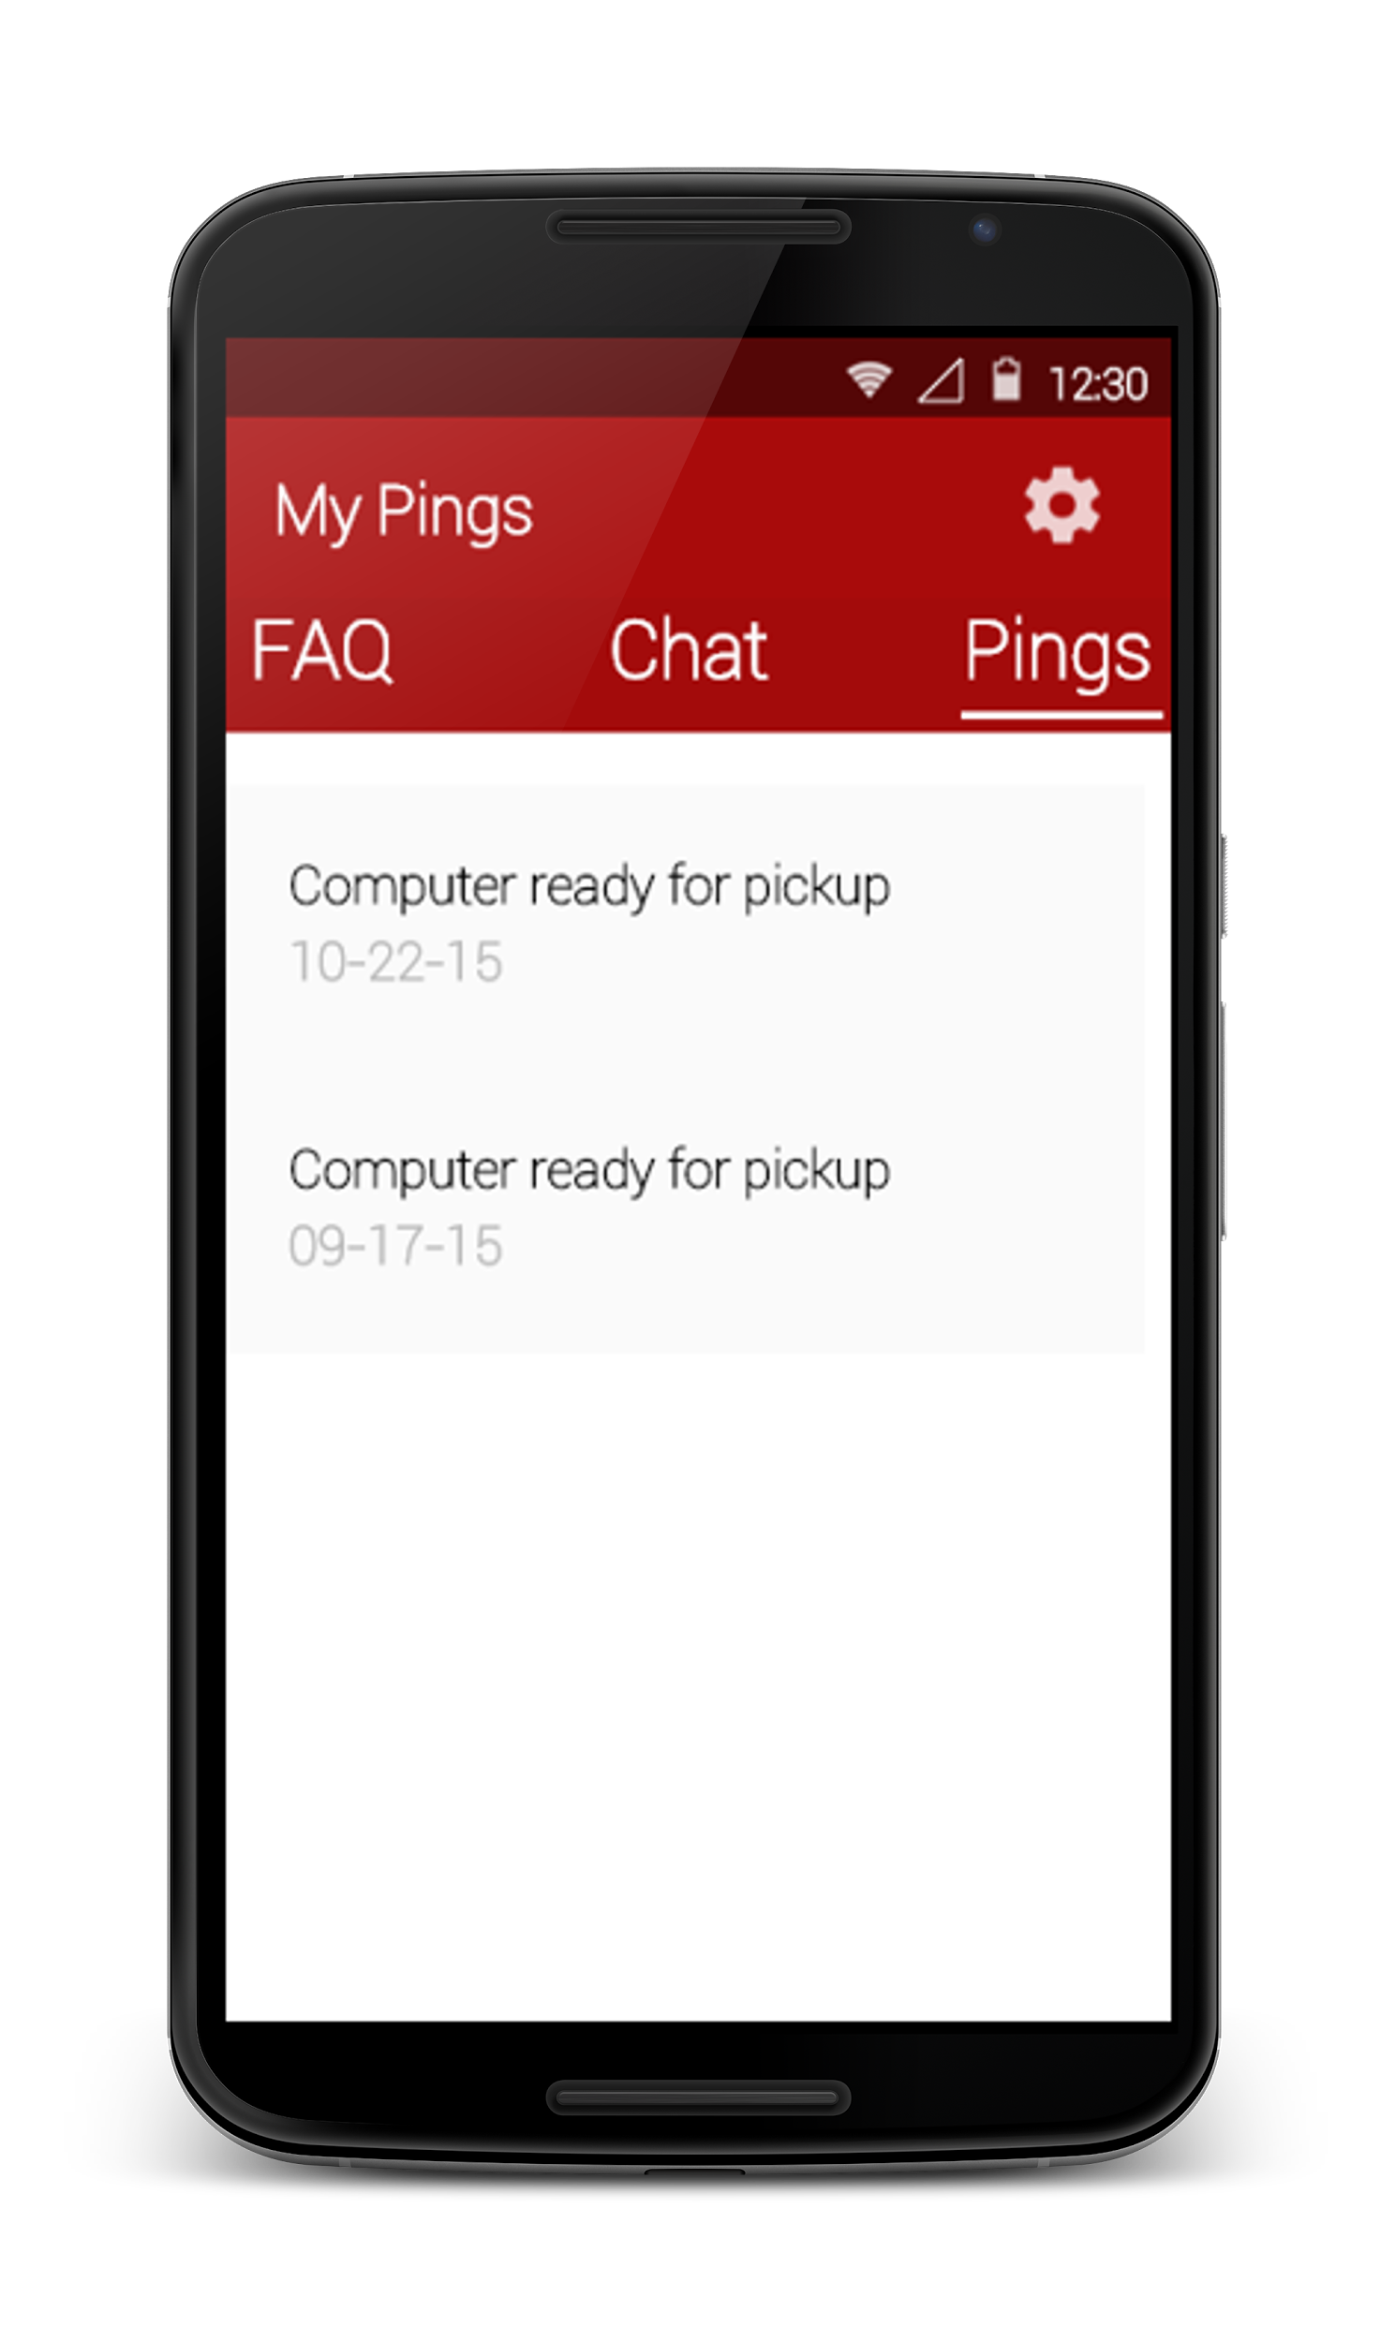
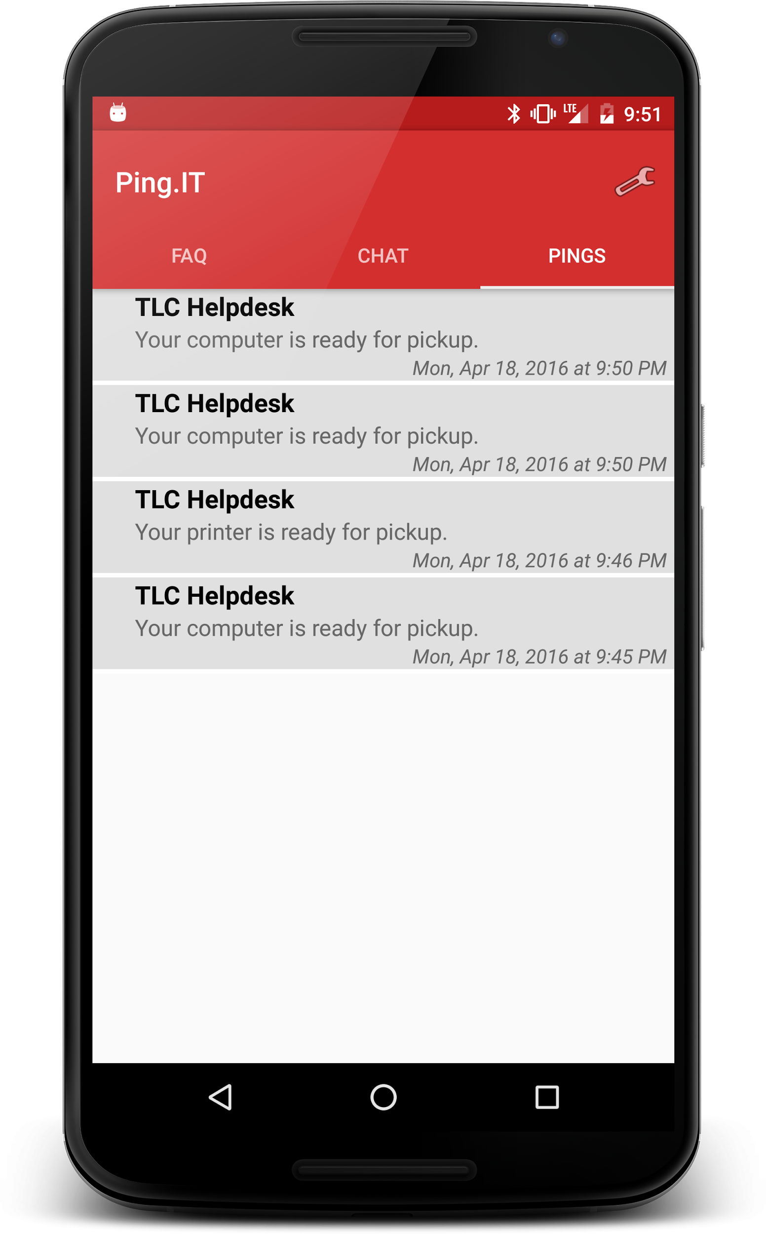
Action Bar Changes
Size
Color
Text
Icon
Before
After

Slide 12
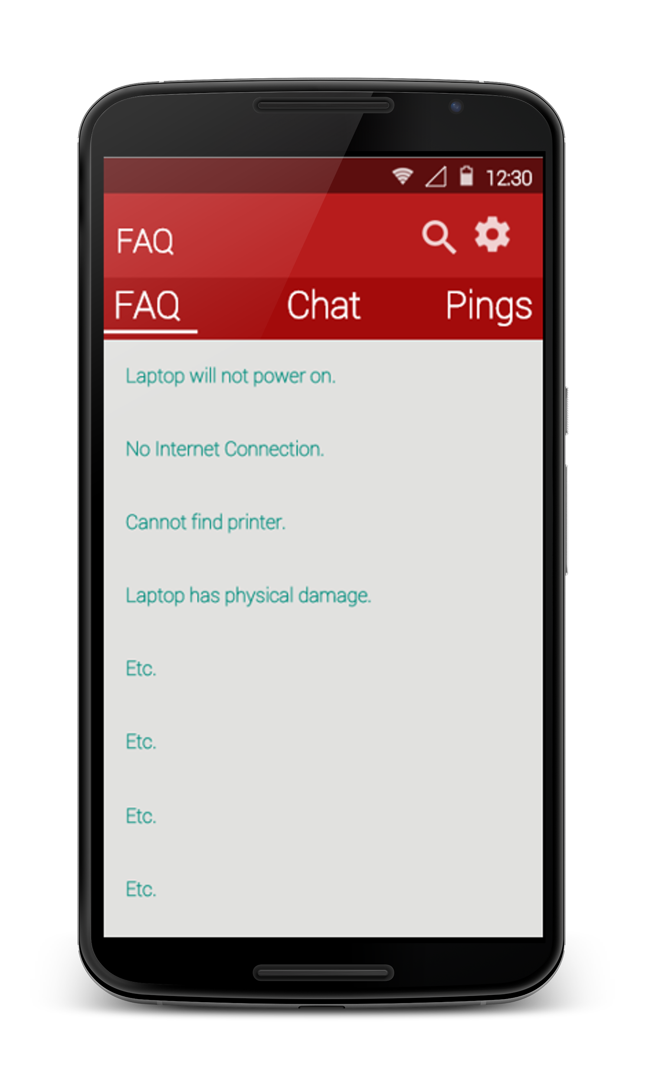
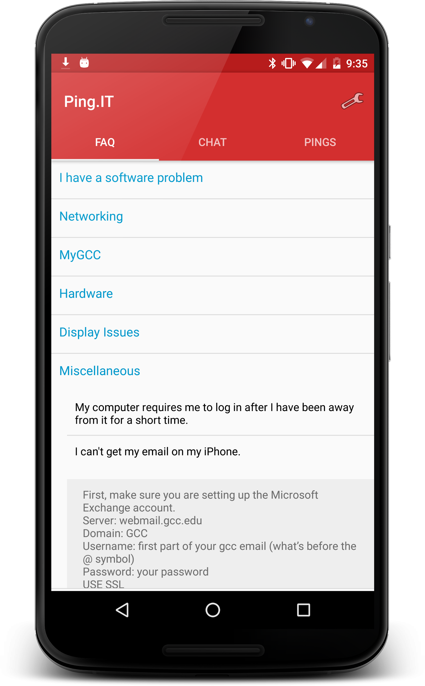
FAQ Changes
Before
After
Removed search
Categories & questions on same activity

Slide 13
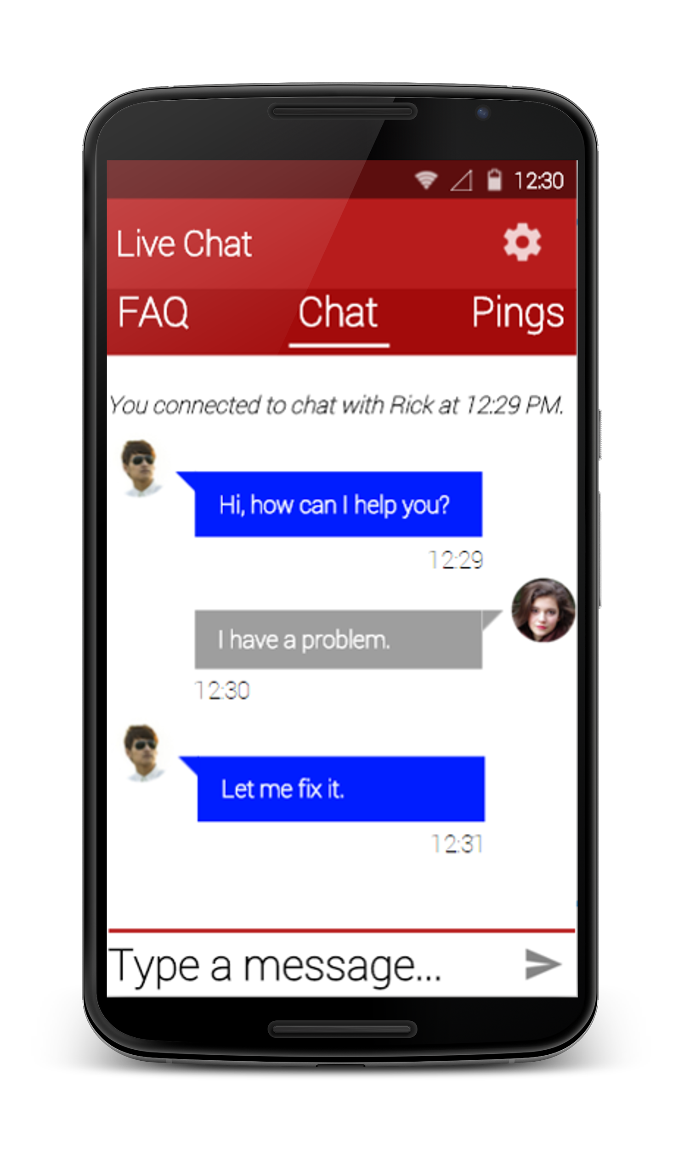
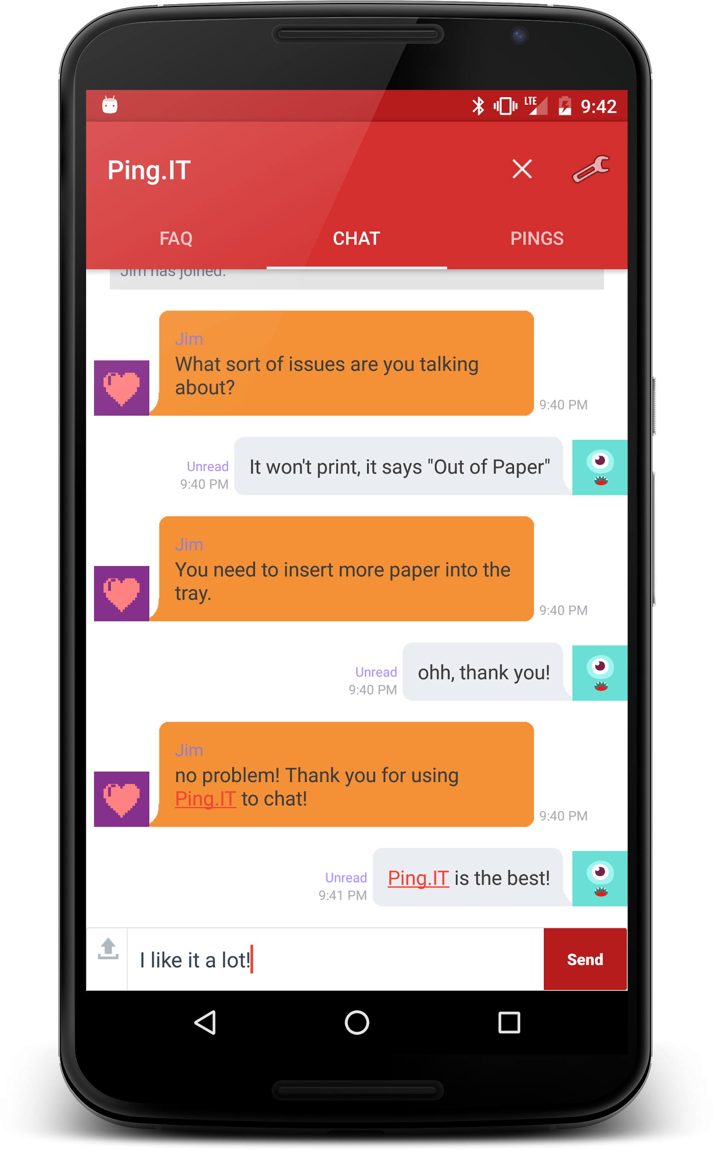
Chat Changes
Before
After
Removed personal pics
Chat color
Close chat on actionbar

Slide 14
Pings Changes
Before
After
Small whitespace
More info per ping
Pull down to refresh

Slide 15
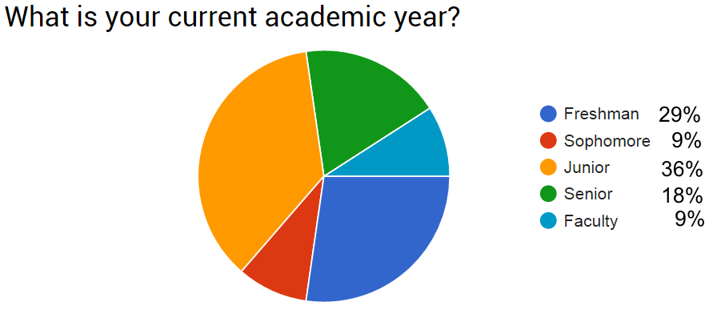
User Testing Results
Surveyed 10 GCC students and one GCC faculty member
Notes:
During our user testing we surveyed [PEOPLE], we got a good spread between grades and had an even split between men and women.

Slide 16
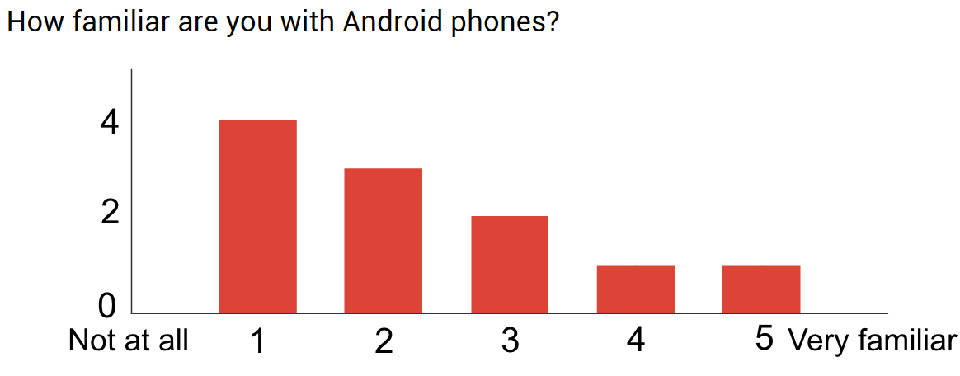
User Testing Results
Most of our users were not familiar with Android...
Notes:
Built to Google’s design guidelines, with the hopes that users familiar with Android would find it intuitive. These results show us that regardless of familiarity with android the users still found it intuitive to use regardless of knowledge of Android.

Slide 17
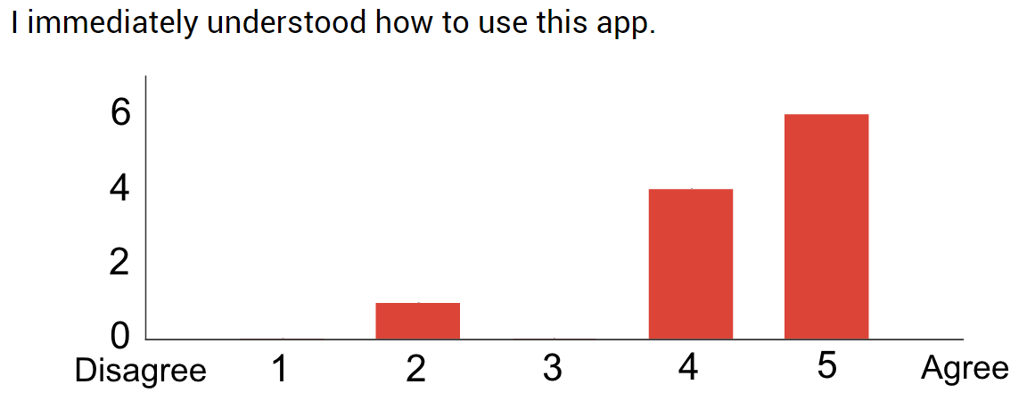
User Testing Results
But Ping.IT is intuitive, even without Android experience.
Notes:
Built to Google’s design guidelines, with the hopes that users familiar with Android would find it intuitive. These results show us that regardless of familiarity with android the users still found it intuitive to use regardless of knowledge of Android.

Slide 18
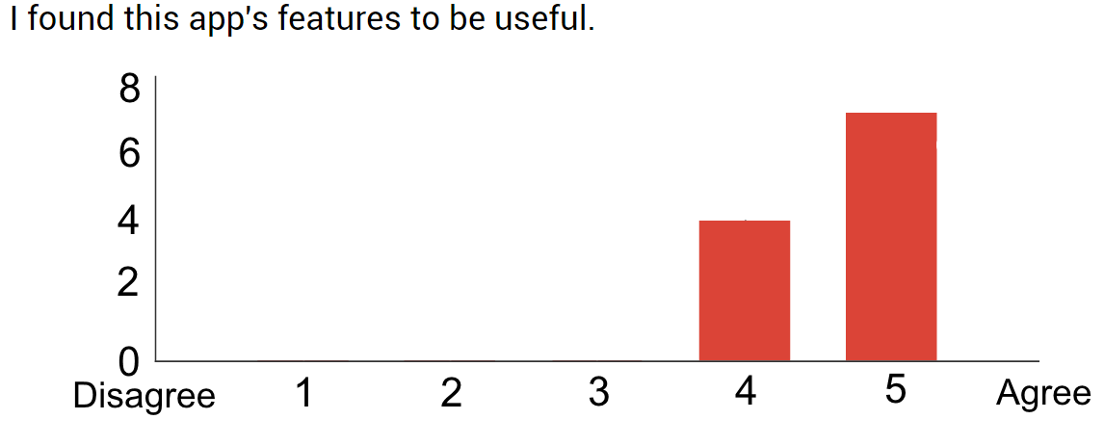
User Testing Results
Ping.IT’s usefulness is clearly evident.

Slide 19
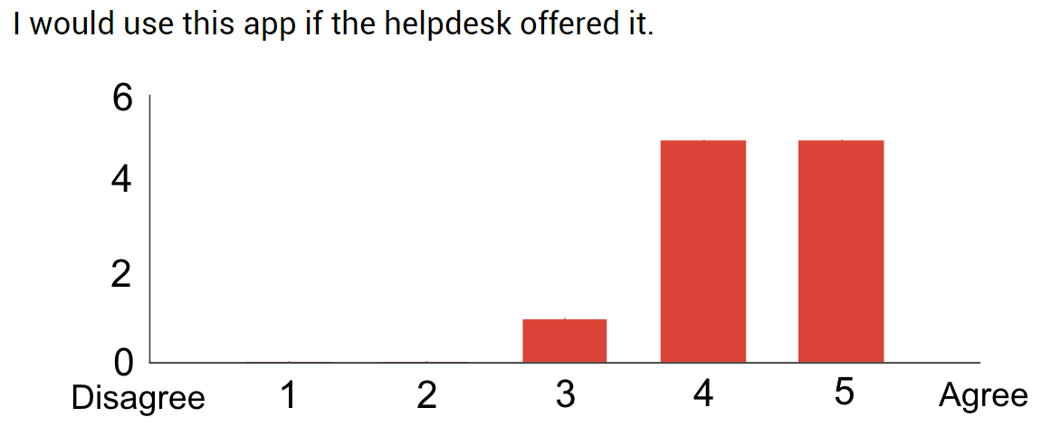
User Testing Results
Students are excited to use it!

Slide 20
Changes from User Testing
Displayed email & password requirements upon registration
Changed “Name” to “First Name”
Updated color of settings icon

Slide 21
Summary
Helpdesk still deciding on use
Students found it to be useful!
Ping.IT is already on Google Play

